Slide 1
Fuzzy-Search Engine
An Error-Tolerant Word Retrieval
SECTION 3
TEAM 4
2520030159 – B. HEMA SRI
2520030371 – P. HAVISHAA

Slide 2
ABSTRACT
This project builds a fuzzy search system that helps users find correct results even when they make typing mistakes. Instead of rejecting misspelled queries, the system compares the entered word with dictionary entries using the Levenshtein Distance algorithm. This algorithm calculates similarity by counting the number of edits needed to change one word into another.
Based on these similarity scores, the system ranks possible matches and suggests the most relevant ones. The design is efficient, allowing it to handle very large dictionaries and support multiple languages without slowing down. This makes the system suitable for applications such as spell checkers, auto‑complete tools, intelligent search engines, and text‑based platforms where speed and accuracy are important.
By tolerating small errors, the fuzzy search reduces frustration, improves accessibility, and ensures meaningful results quickly. Overall, it shows how smart algorithms can make digital interactions smoother, more reliable, and inclusive across languages and contexts.

Slide 3
PROBLEM STATEMENT
People often type search queries with spelling mistakes.
Current search systems fail to return useful results when errors occur.
This makes searching frustrating and less effective.
A fuzzy search system is needed to handle typos and still provide relevant matches.
The goal is to make searching smoother and more reliable for users.

Slide 4
PROPOSED FUNCTIONALITIES
Error‑tolerant search: Accepts misspelled queries and still finds relevant results.
Edit distance calculation: Uses Levenshtein Distance to measure similarity between input and dictionary words.
Ranking system: Scores and sorts matches based on closeness to the query.
Large dictionary support: Efficiently handles big word lists without slowing down.
Multilingual capability: Works across multiple languages for wider usability.
Practical integration: Can be applied in spell checkers, auto‑complete tools, and intelligent search engines.

Slide 5
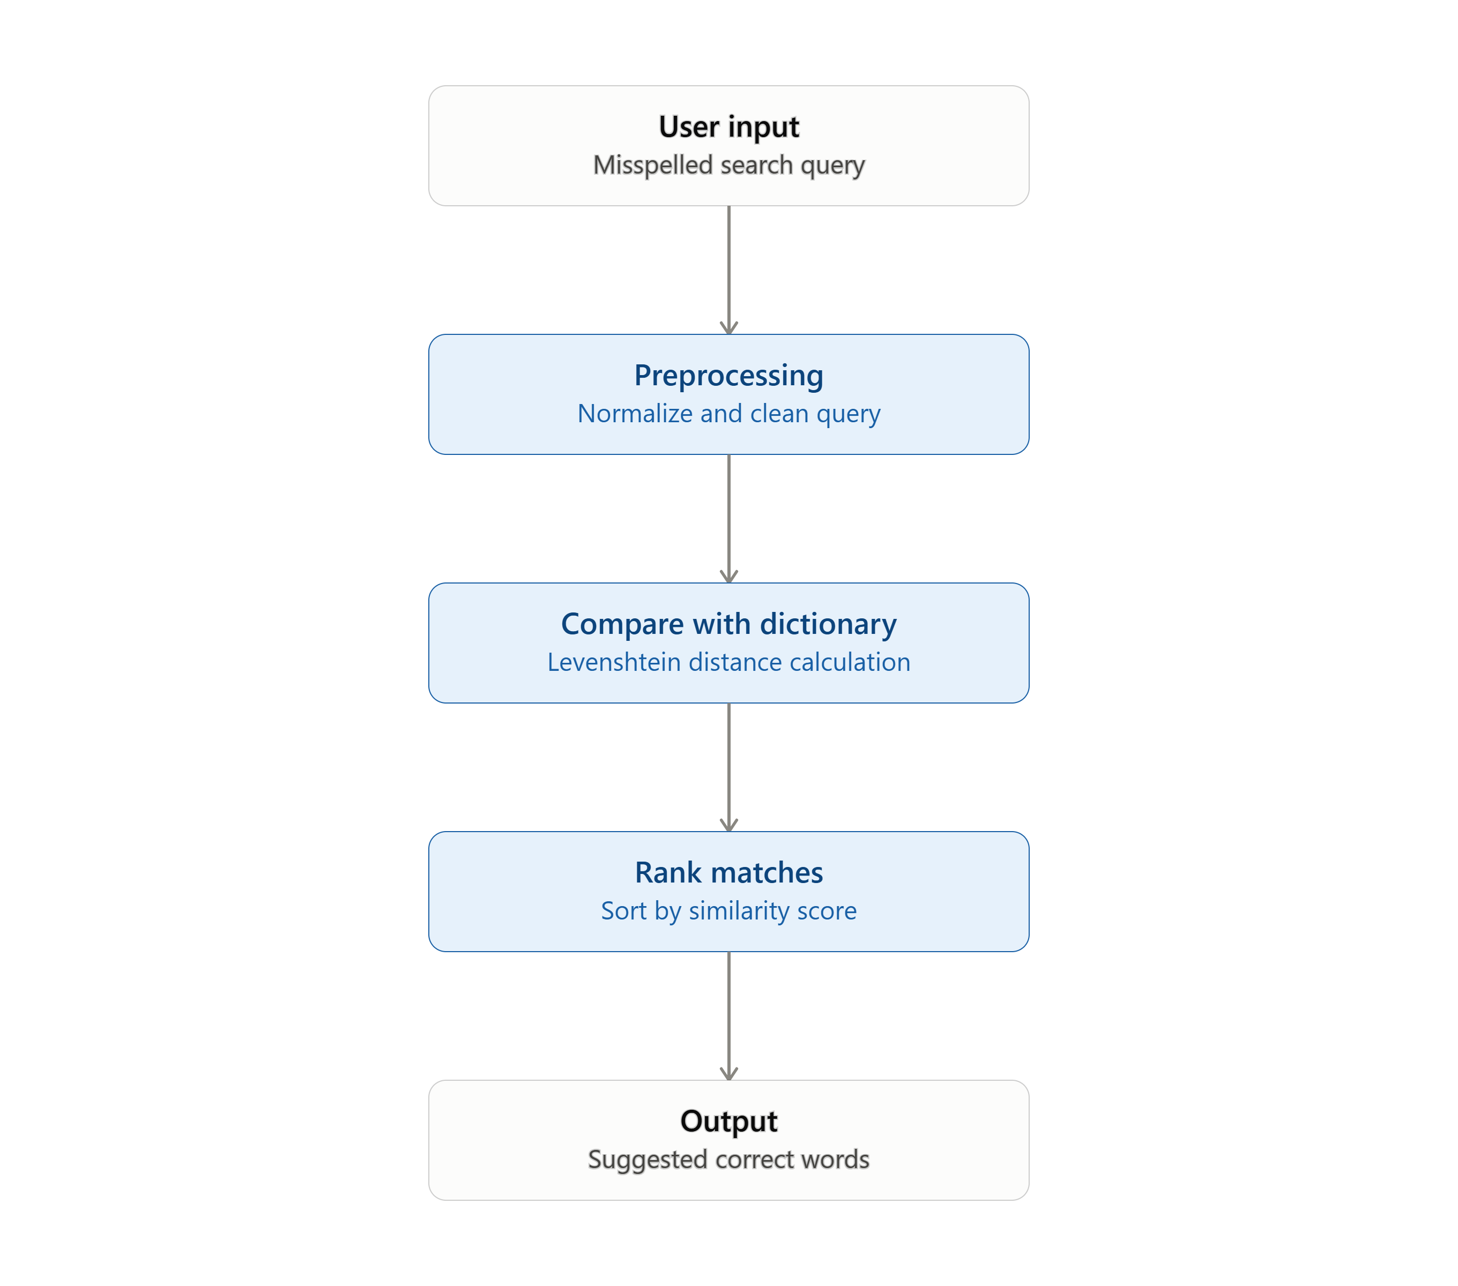
PROJECT FLOW DIAGRAM

Slide 6
METHODOLOGY
Step 1 – User Input User enters a word (possibly misspelled).
Example: “aplpe” instead of “apple”
Step 2 – Preprocessing Normalize input (trim spaces, convert to lowercase). Load dictionary words from a text file.
Step 3 – Similarity Calculation: Apply Levenshtein Distance algorithm to measure edit distance. Formula: minimum number of insertions, deletions, or substitutions needed.
Example: aplpe → apple requires 2 edits.
Step 4 – Matching & Ranking Compare input with all dictionary words. Store similarity scores in a HashMap. Rank words by lowest edit distance (highest similarity).
Step 5 – Output Generation Display top matches to the user. Results shown in order of similarity score.

Slide 7
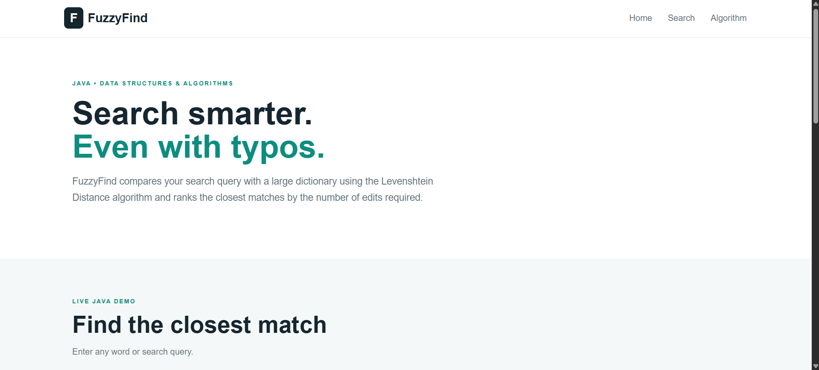
WEBSITE SNIPPETS

Slide 8
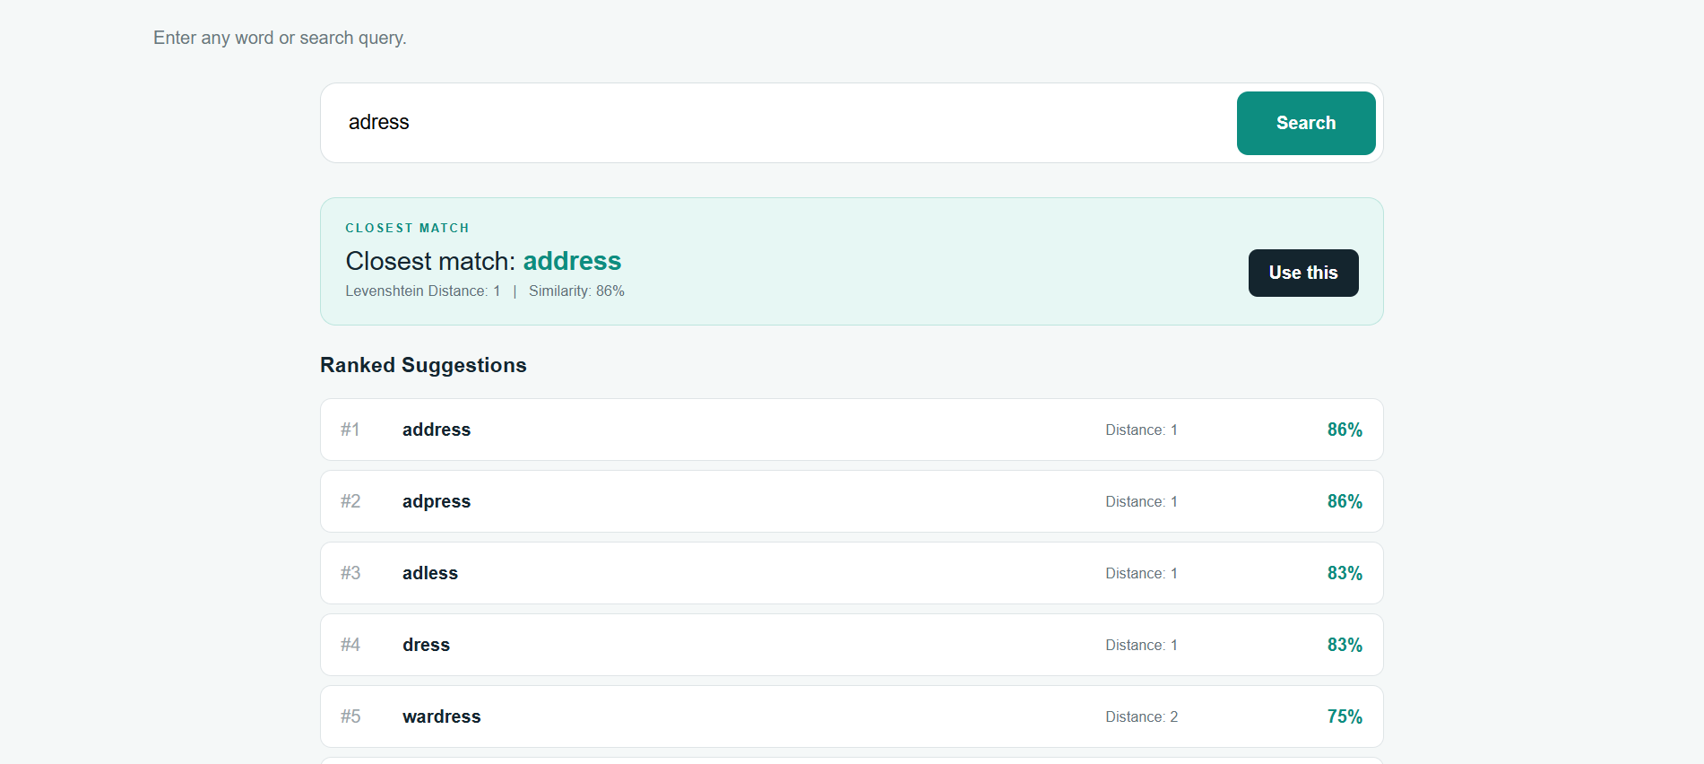

Slide 9
PROJECT SUMMARY
The fuzzy search system takes a word or search query entered by the user - it can be misspelled or incomplete.
It processes these results by scoring and ranking the closest matches, ensuring that even misspelled or imperfect queries return meaningful suggestions.
Finally, it outputs a clean list of ranked words, making the system practical for spell checkers, auto-complete features, and intelligent search engines.
This process takes place by using edit distance algorithms like Levenshtein distance.

Slide 10
THANK YOU

